Slide 1
You open a business today who would you like to work with?
Today Topic

Slide 2
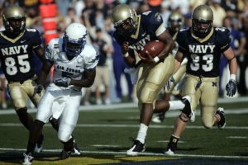
Building Effective Teams

Slide 3
A TEAM

Slide 4
A team is more than just a group of people who happen to work together.
It is a group of people working towards common goals and objectives and sharing responsibility for the outcomes.
A team may be composed of people drawn from different functions, departments, and disciplines who have been brought together for a specific project.

Slide 5
Effective Team in Business

Slide 6
An effective team in business is a group of individuals working together collaboratively to achieve common goals and objectives.

Slide 7
What Makes an Effective Team in Business?

Slide 8
who you should include in your team.

Slide 9
Team Roles
Members of a team should be selected with an eye toward filling all the roles that need to be allocated.
There are about nine different roles needed on a team and, while members can fill more than one of these roles, members should be matched to those team role demands.

Slide 10
The Plant. Creative, imaginative. Solves problems.
The Resource Investigator. Communicative. Explores opportunities and develops contacts.
The Coordinator. Clarifies goals, and promotes decision-making.
The Shaper. Dynamic, challenging, thrives on pressure. Overcomes obstacles.
The Monitor-Evaluator. Strategic and discerning. Sees all options and judges accurately.

Slide 11
The Team worker. Co-operative and perceptive. Listens, builds, averts conflict.
The Implementer. Conservative and efficient. Turns ideas into practical actions.
The Completer/Finisher. Conscientious. Searches out errors meet deadlines.
The Specialist. Self-starting and dedicated. Provides knowledge/skills in rare supply.

Slide 12
Managers need to understand the strengths each team member brings to the table and select members for the team with those strengths in mind.
Team Diversity
The diversity of a team also plays a deciding factor in how productive and successful the team is. Of course, there needs to be a diversity of skills, but if a team also features members of diverse age, gender, education, functional background, and experience, this bodes well for them.

Slide 13
Keep in mind, however, that having a team with individuals from various cultures on a single team often does not spell instant success, as team members have a longer learning curve understanding how to work with one another.

Slide 14
Team Size
The size of the team makes a difference in a team’s success. Studies show that a team should be made up of no more than ten people, and optimally, no more than exactly the number of team members that are necessary to do the work.

Slide 15
What issues must a manager address when considering the composition of the team?
The right design for the positions team members will hold
Abilities, personalities and diversity of team members
Common purpose, specific goals, and team efficacy
Adequate resources, structure and trust.

Slide 16
POTENTIAL PITFALLS

Slide 17
Managers should avoid:
Expecting a new team to perform effectively from the word go
Dominating the work of the team, whether intentionally or unconsciously
Exercising excessive control which may stifle creativity
Overlooking the influence of formal and informal team roles
Allowing the team to lose focus on the tasks to be completed

Slide 18
Let a team become too exclusive, in case it loses touch with the rest of the organization
Allowing individuals to take credit for the achievements of the team
being overly dependent on providers of team building activities – these can help, but their role in
developing a team needs to be carefully managed. A team does not automatically materialize at
the end of a team-building course.

Slide 19
Why is team effectiveness important?

Slide 20
Team effectiveness is important because high-performing teams deliver results and it’s what your employees want – 37% say “working with a great team” is their primary reason for staying with an employer.
When deep trust and high expectations work together, businesses see higher employee engagement, better business outcomes, and significant boosts in ROI.

Slide 21
Research shows that engaged and effective teams show 21% greater profitability (Source: Gallup) and that 72% of organizations say team performance has a positive impact on productivity (Source: Brandon Hall).
In their book “Teams that Work—The Seven Drivers of Effectiveness,” authors Tannenbaum and Salas tell us that effective teams benefit from the following:

Slide 22
Sustained team performance: The team generates positive results over time.
Team resilience: They work through challenges and bounce back from adversity.
Vitality: The team maintains energy, vibrancy, and resources needed for future success.

Slide 23
What does a high-performing team look like?

Slide 24
Deep Trust
Team members know and appreciate each other as individuals.
Each person can show up, speak up, and contribute without fear of punishment, humiliation, or manipulation.
Everyone receives authentic appreciation and constructive, candid feedback.
Productive and respectful dialogue and debate are fostered.

Slide 25
High Expectations
Team purpose is explicit, consequential, strengthening, and aligning.
Team and individual goals are compelling and require learning and teamwork to achieve.
Team practices cultivate and value diverse perspectives, effective collaboration, and “group genius.”
Team is committed to a high standard of excellence and the ongoing learning required to achieve it.

Slide 26
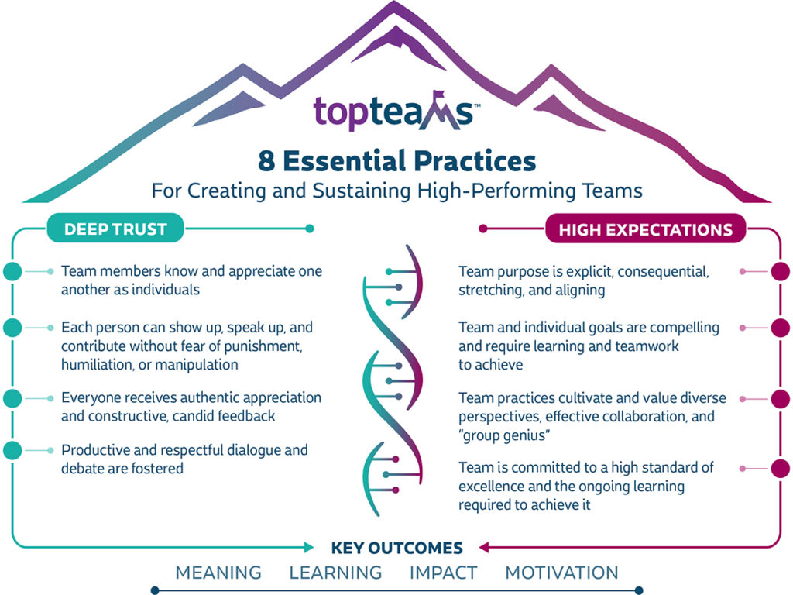

Slide 27
Creating an All-Star team
1. Develop your leadership skills
2. Set SMART goals
3. Establish meaning and purpose
4. Define roles and responsibilities
5. Embrace diversity
6.Make hiring a team effort
7. Communicate effectively
8.Focus on relationships
9. Invest in team development

Slide 28
A team is only as good as the person coaching it. Identify your leadership strengths and weaknesses and work to develop strong communication skills with active listening.
The key to developing your leadership skills is to focus on skills that every manager, regardless of personality, needs to have including:
A growth mindset
Empathy and high emotional intelligence (EQ)
Robust communication skills
Agility, flexibility, and reliability
Ability to receive, and give, effective and construction feedback
Decisiveness
Develop your leadership skills

Slide 29
2. Set SMART goals
The SMART in SMART goals stands for Specific, Measurable, Achievable, Relevant, and Time-Bound and utilizing this approach can help your team stay accountable. It eliminates generalities and guesswork, sets a clear timeline, and makes it easier to track progress and identify missed milestones.
SMART goals are:
Specific: Well defined, clear, and unambiguous.
Measurable: With specific criteria that measure your progress toward the accomplishment of the goal.
Achievable: Attainable and not impossible to achieve.
Realistic: Within reach, realistic, and relevant to your purpose.
Timely: With a clearly defined timeline, including a starting date and a target date. The purpose is to create urgency.

Slide 30
3. Establish meaning and purpose
As a leader, it’s your job to help your employees and teams find meaning in their work. To uplevel productivity and motivation, have discussions around the “why” of your team’s tasks. Have them meet with customers (both internal and external) and learn how their work affects their lives or jobs.
Look for areas of opportunity to increase skills sets and recognize when team members are improving. Pair people together so they can build relationships, create trust, and deepen connections.

Slide 31
4. Define roles and responsibilities
Teams function most efficiently when members share a common understanding of each others’ roles and responsibilities.
When roles and responsibilities are clearly defined, team members are more productive. There is less duplication of effort; less confusion, disappointment, and frustration; and greater productivity.

